Slide 1
A Comprehensive Analysis of Global Financial Metrics
Group 1
- Manoj Padala
- Moustapha Cisse
- Yasaswitha Gaddam

Slide 2
Introduction
In this project, we'll be working to analyze data over a 15-year period over several financial indices.
The datasets that we used for our project are listed below: Nasdaq, S&P 500, BTC, Crypto10 Index, Gold, Silver, Nifty100, European Stock Market Index, China Stock Market Index, Japan Stock Market Index, Singapore Stock Market Index, Gold Index, Silver Index, Crude Oil, and Natural Gas are the datasets that we used to work on this project. We acquired all of these data sets from investing.com.

Slide 3
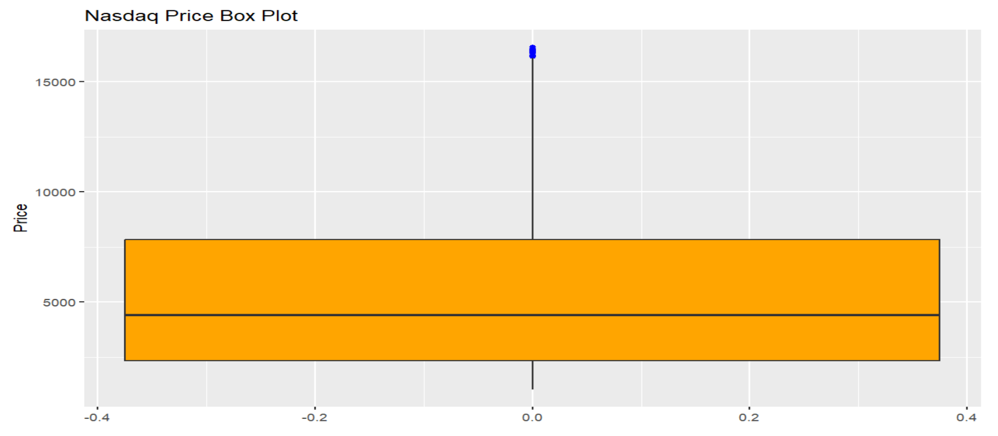
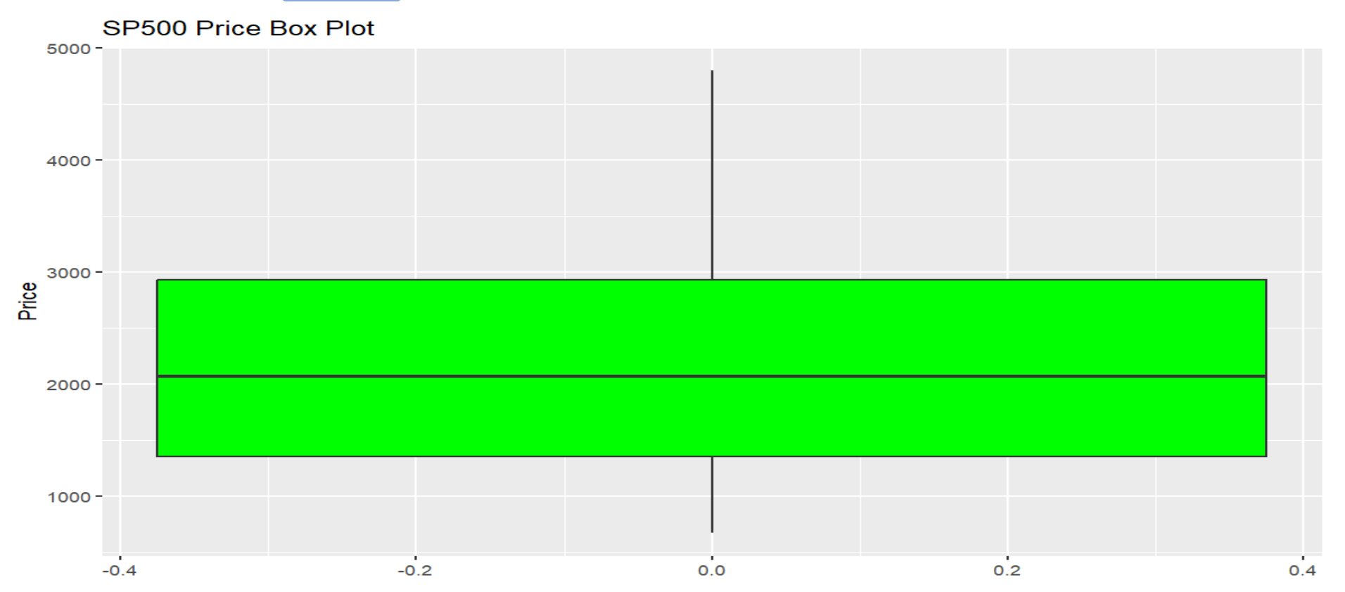
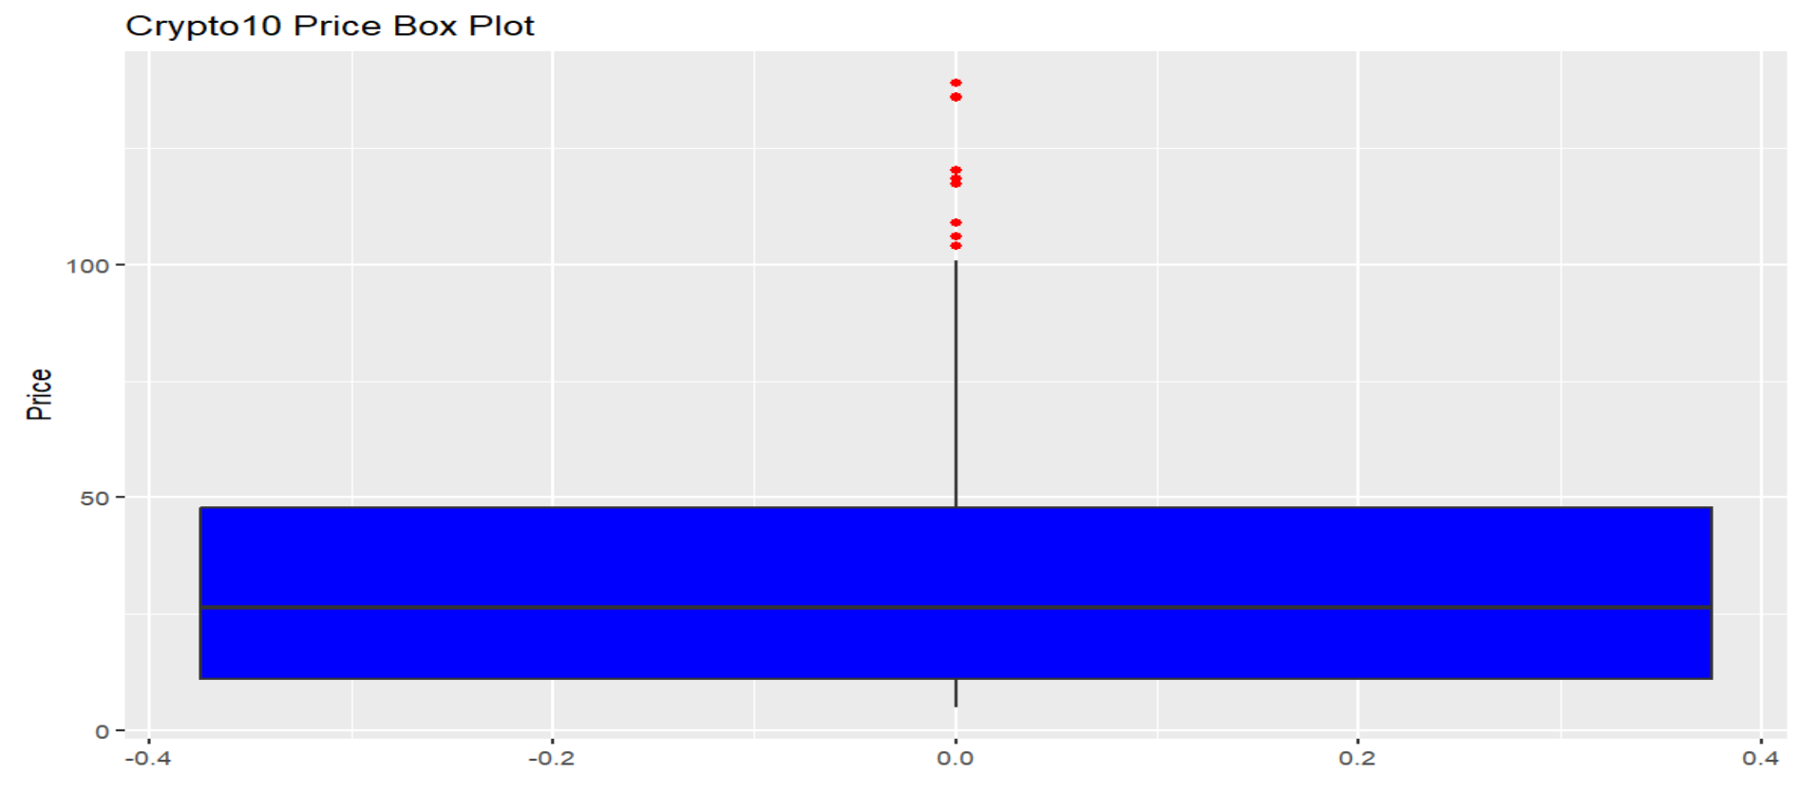
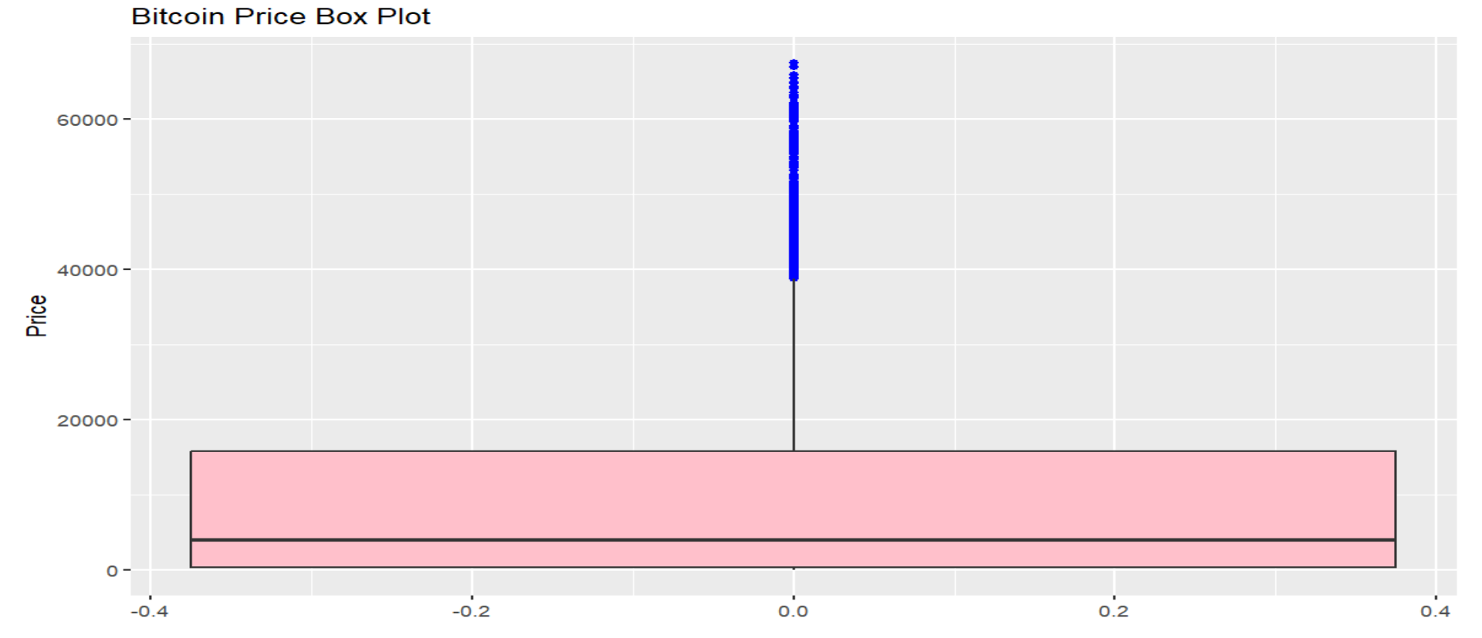
BOXPLOTS

Slide 4
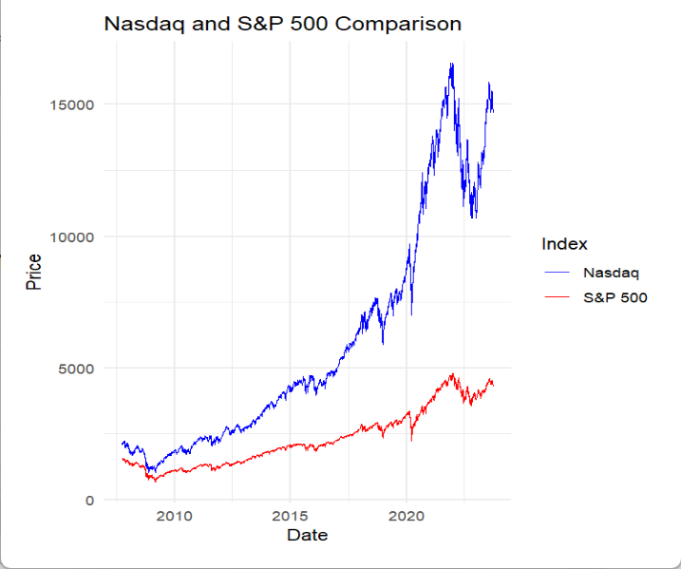
:
NASDAQ AND S&P500
Correlation coeficient = 0.988213

Slide 5
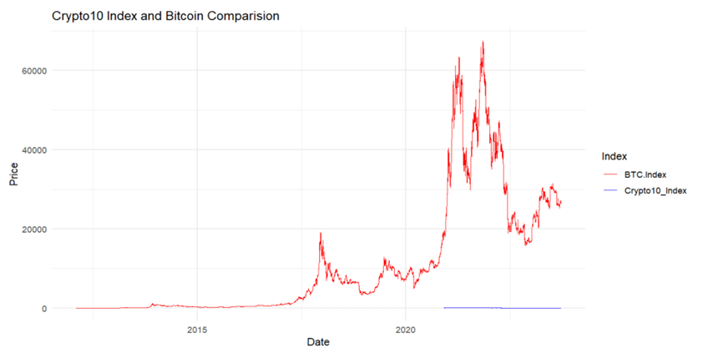
CRYPTO 10 and BITCOIN
Correlation coeficient = 0.988213

Slide 6
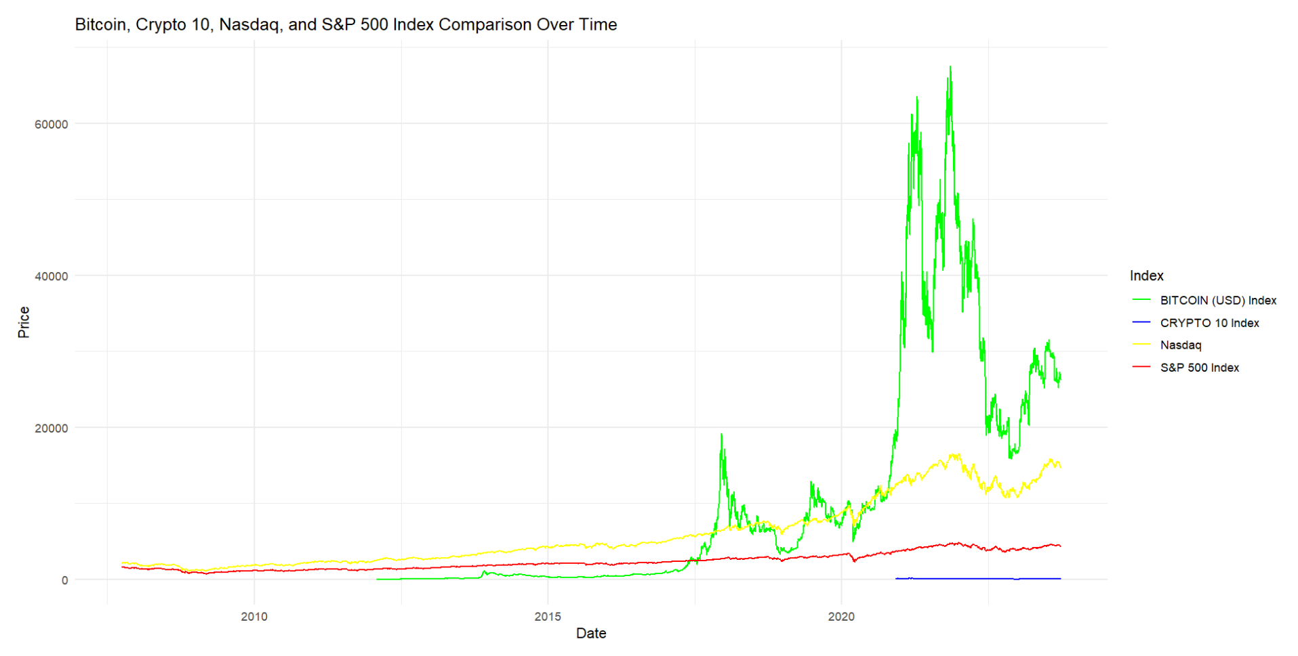
Bitcoin, Crypto 10, Nasdaq, and S&P 500 Index Comparison Over Time
Correlation Coefficient:
Nasdaq - Crypto 10 Index = 0.287
Bitcoin – Nasdaq = 0.899

Slide 7
Question 2: How the fluctuations in the prices of Gold, Silver, Natural Gas and Crude Oil in the global markets have affected the performance of the US Dollar over the last 15 years?
Moustapha Cisse

Slide 8
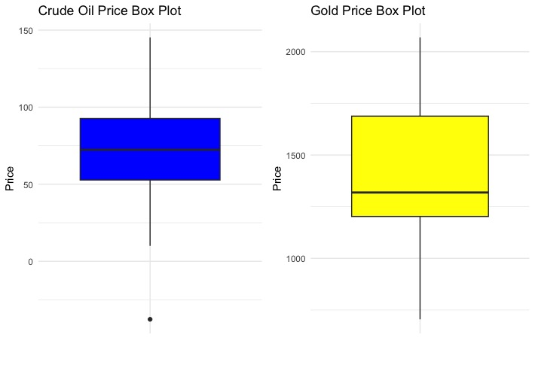
Boxplots
Crude oil:
- one or few outliers
Gold Index

Slide 9
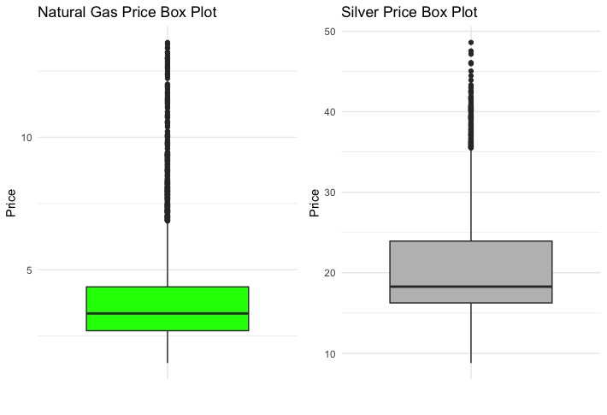
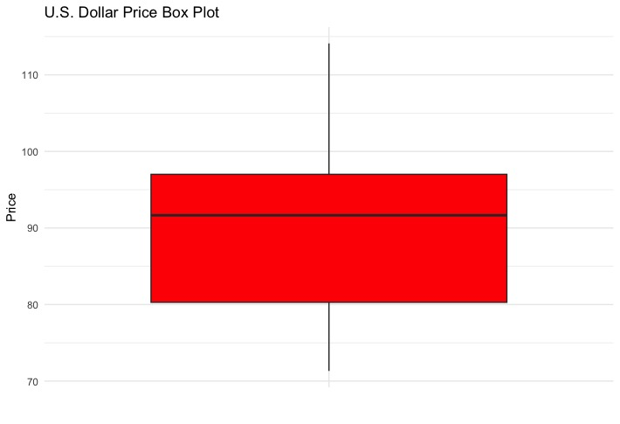
Outliers:
- Natural Gas Index
- Silver Index
U.S. Dollar Index
- no outliers

Slide 10
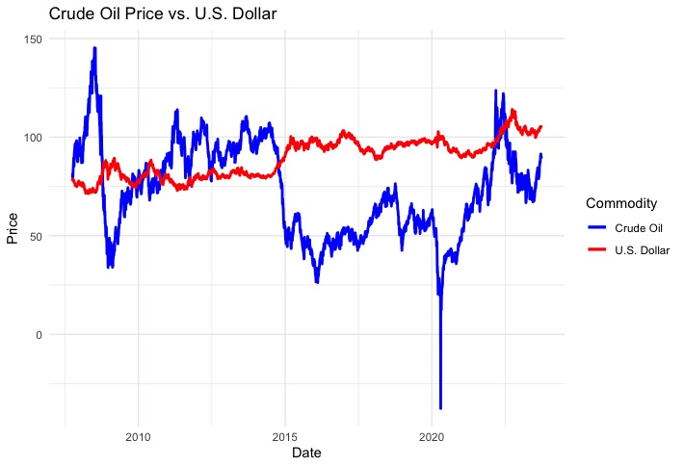
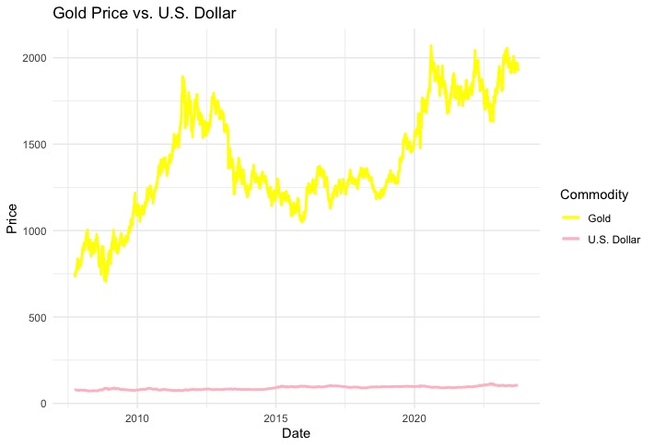
Line plots
Crude oil Index & U.S. Dollar index (inverse)
Corr coef = -0.5576336
Gold Index & U.S. Dollar index (none changes)
Corr coef= 0.3801943

Slide 11
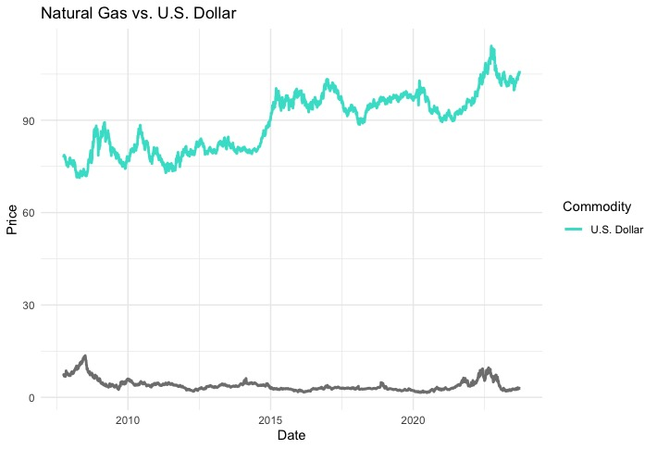
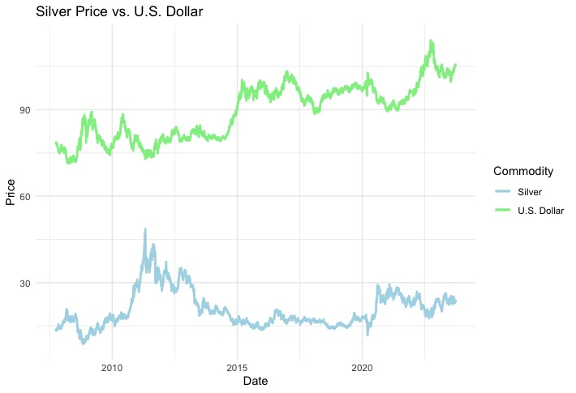
Silver Index & U.S. Dollar Index (negative)
Corr coef = -0.3119592
Natural Gas Index & U.S. Dollar Index (inverse)
Corr Coef = -0.3524114

Slide 12
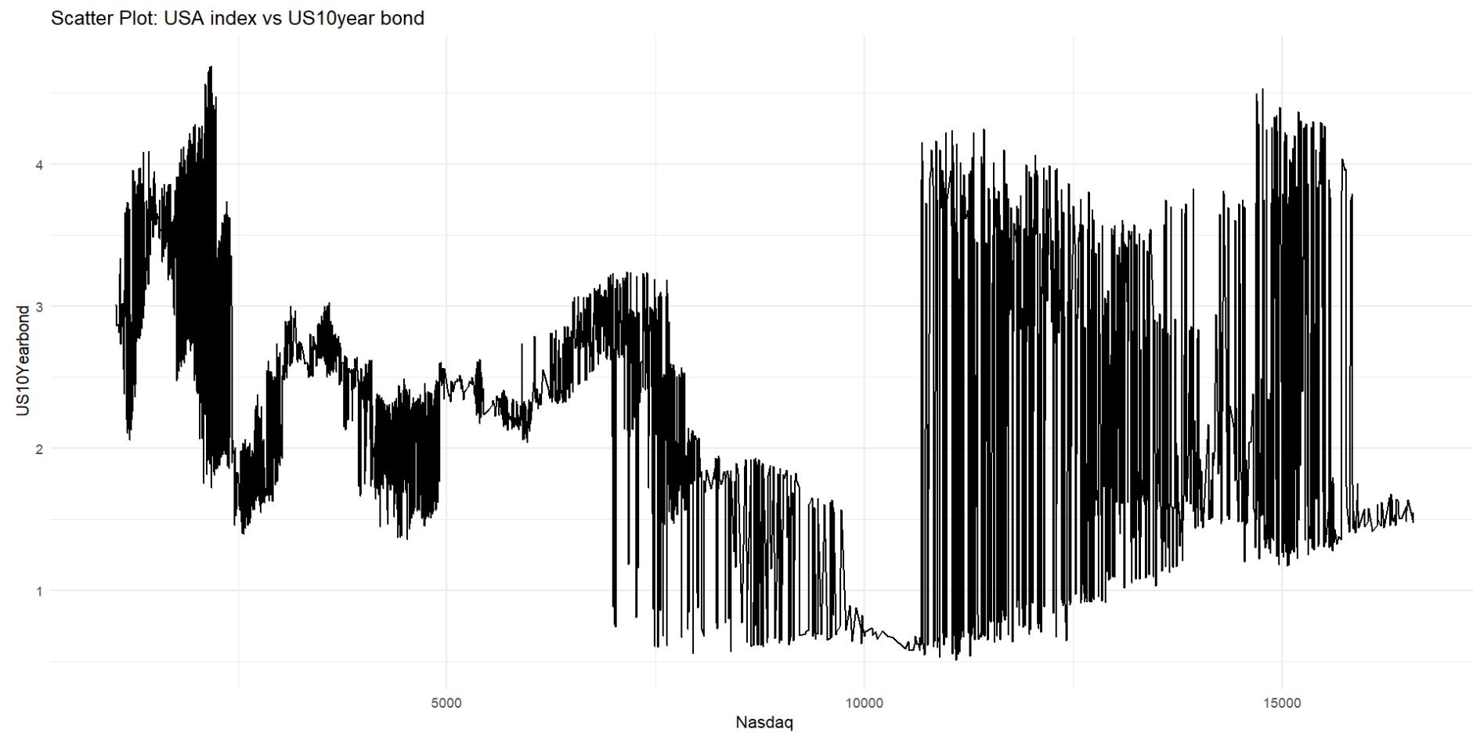
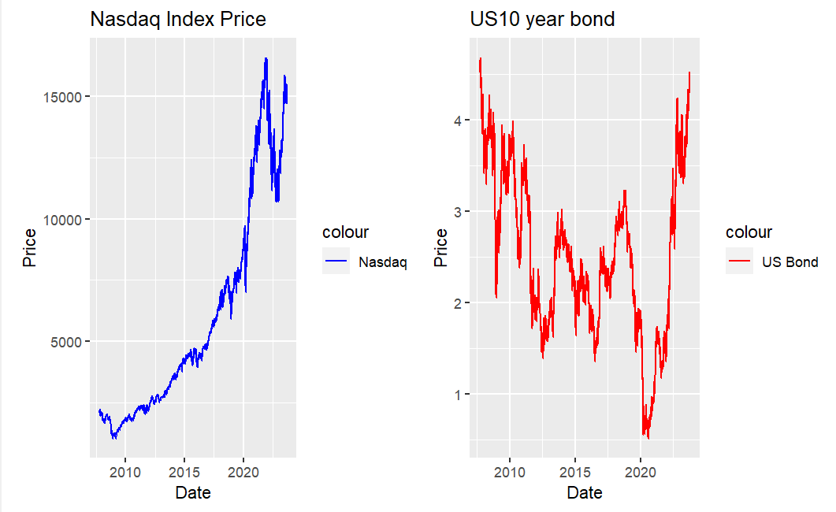
USA index vs US10year bond
Correlation Coefficient = -0.271

Slide 13
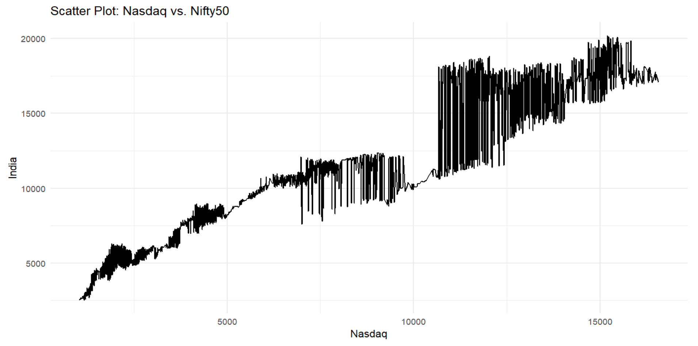
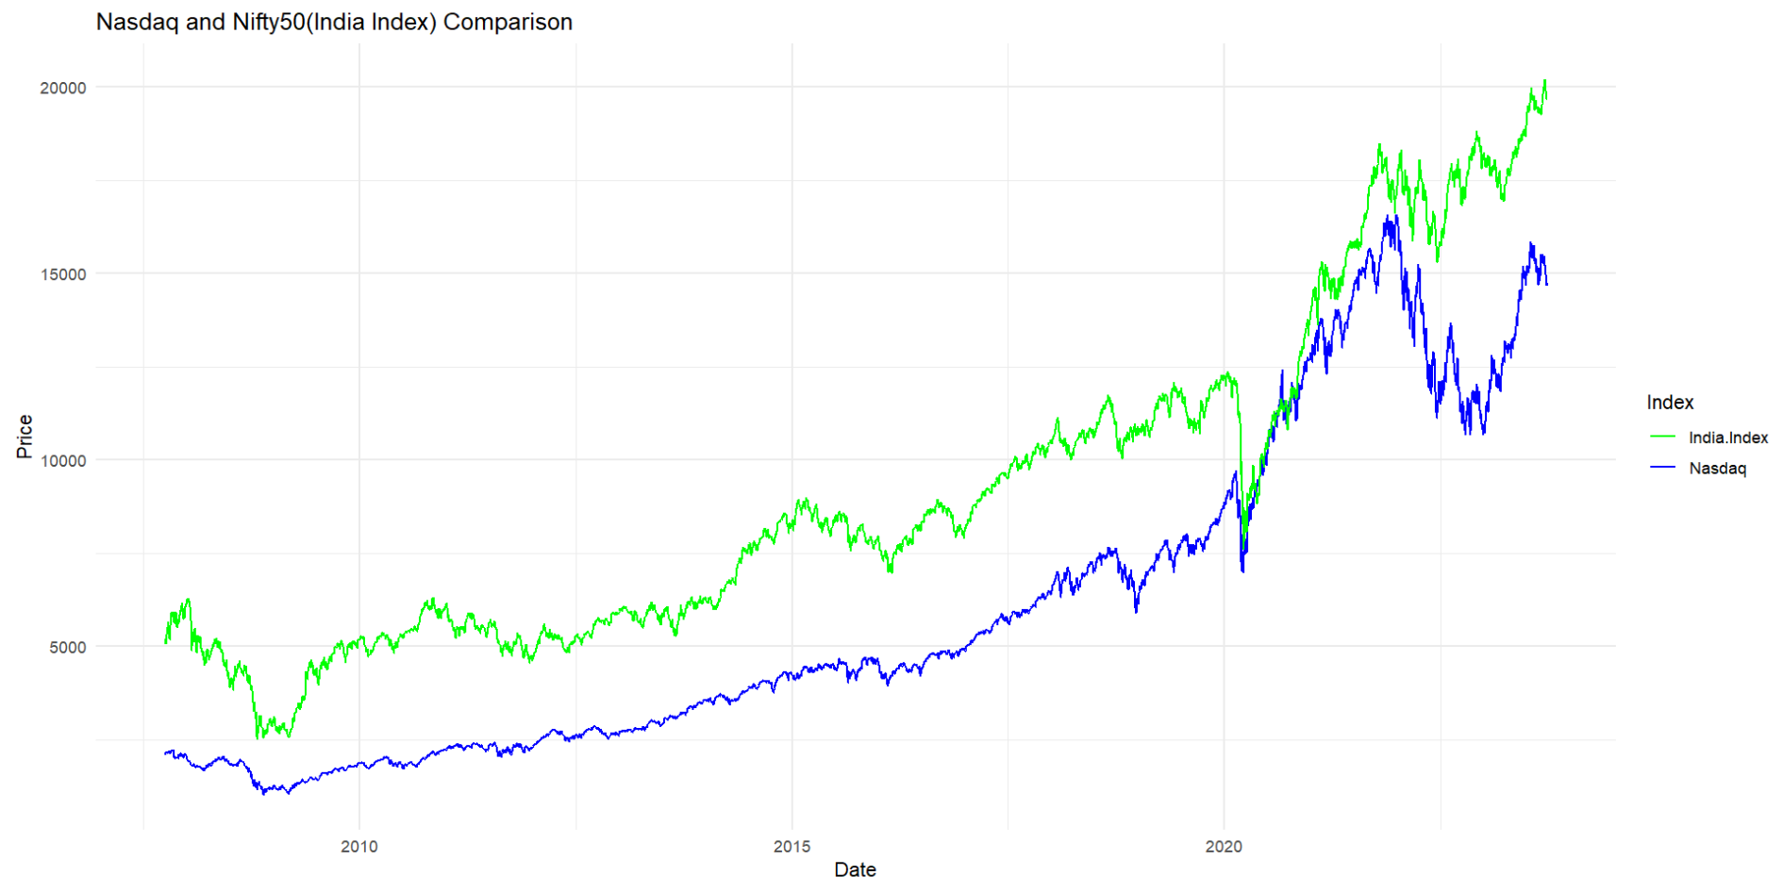
INDIA and USA
Correlation Coefficient = 0.964

Slide 14
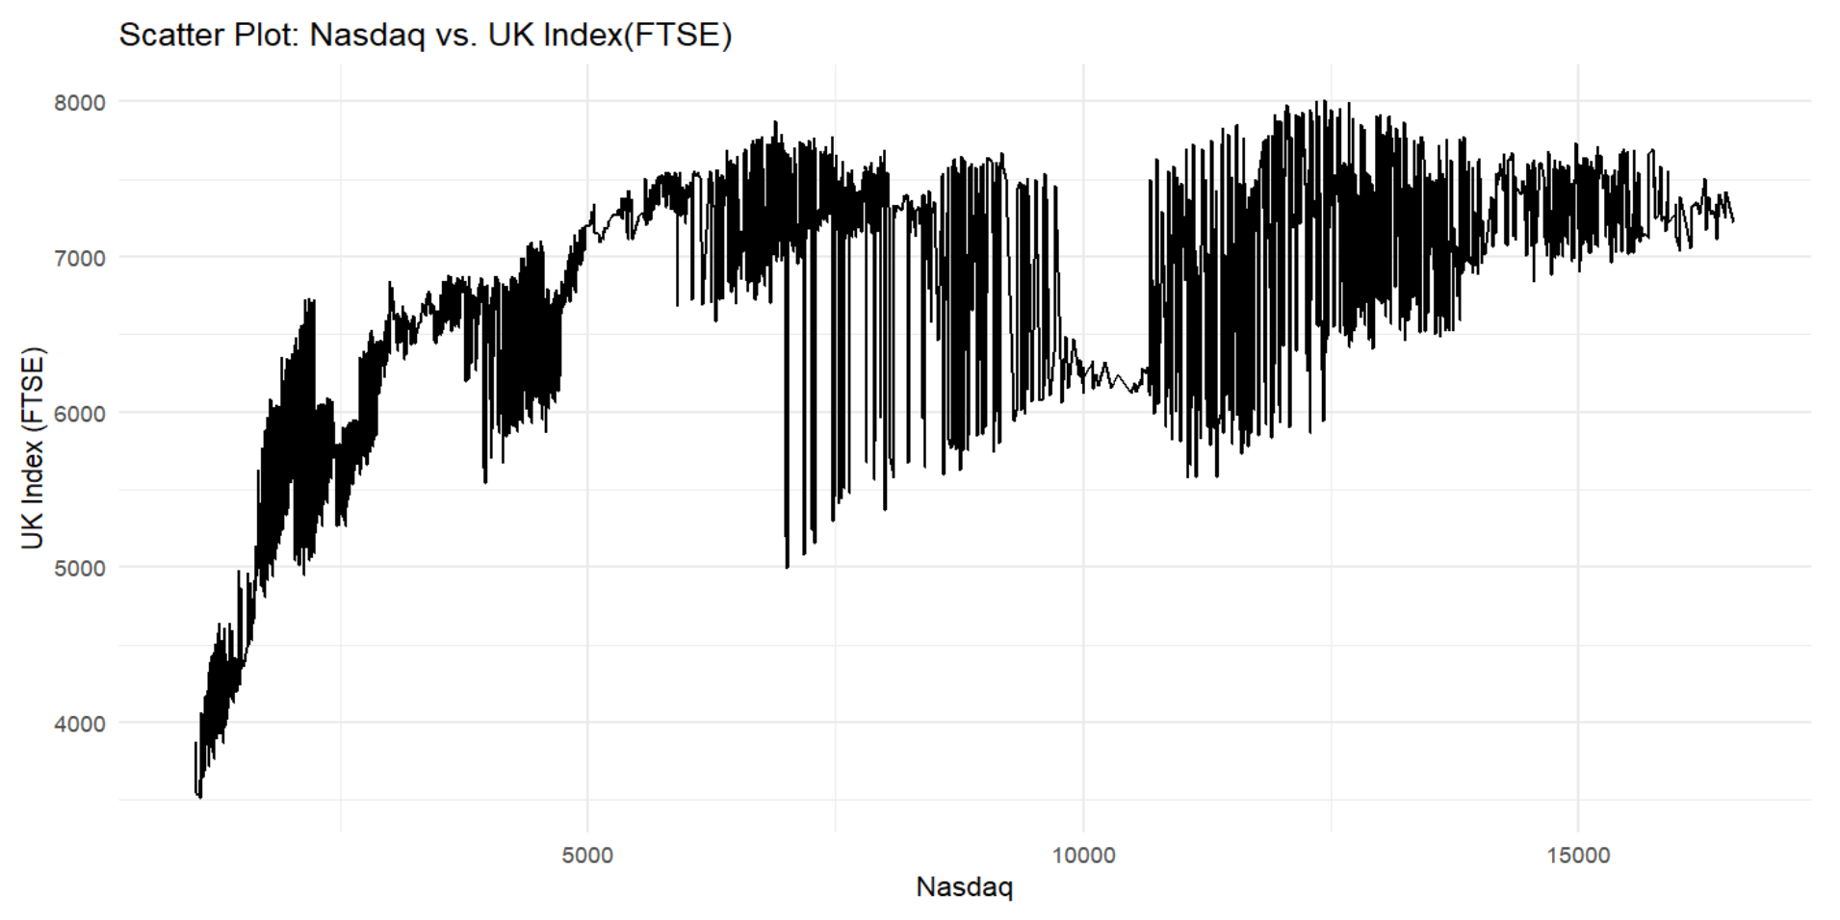
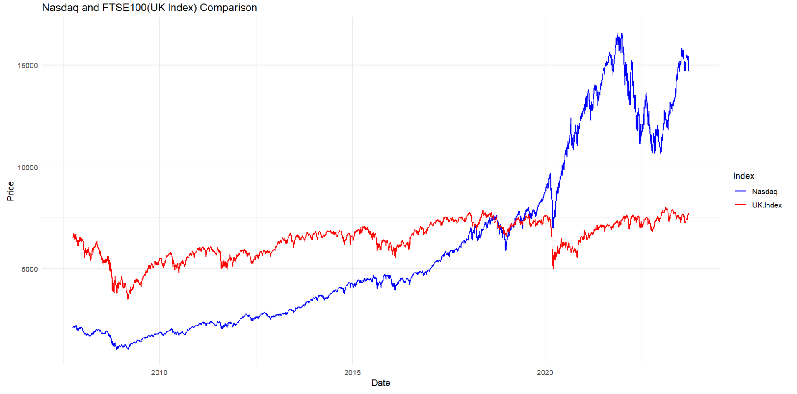
UK and USA
Correlation Coefficient = 0.657

Slide 15
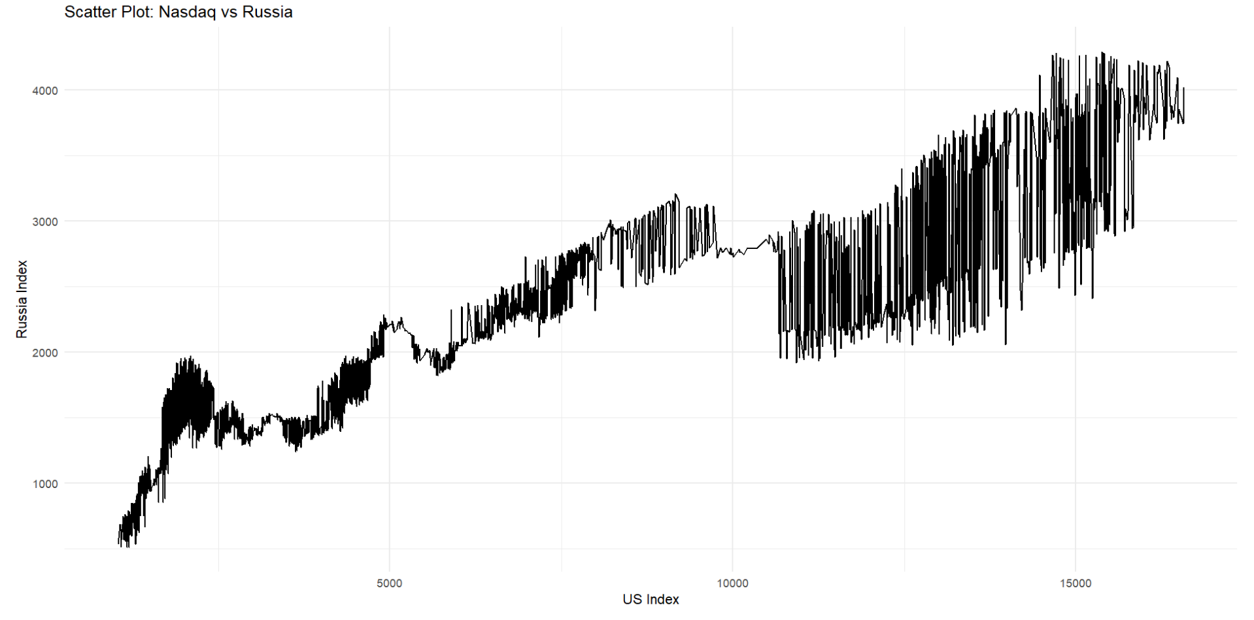
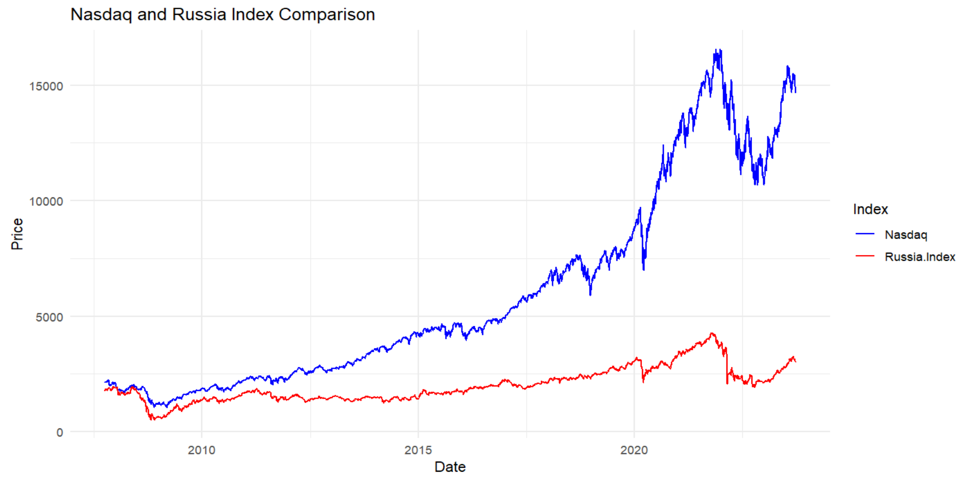
USA and Russia
Correlation Coefficient = 0.892

Slide 16
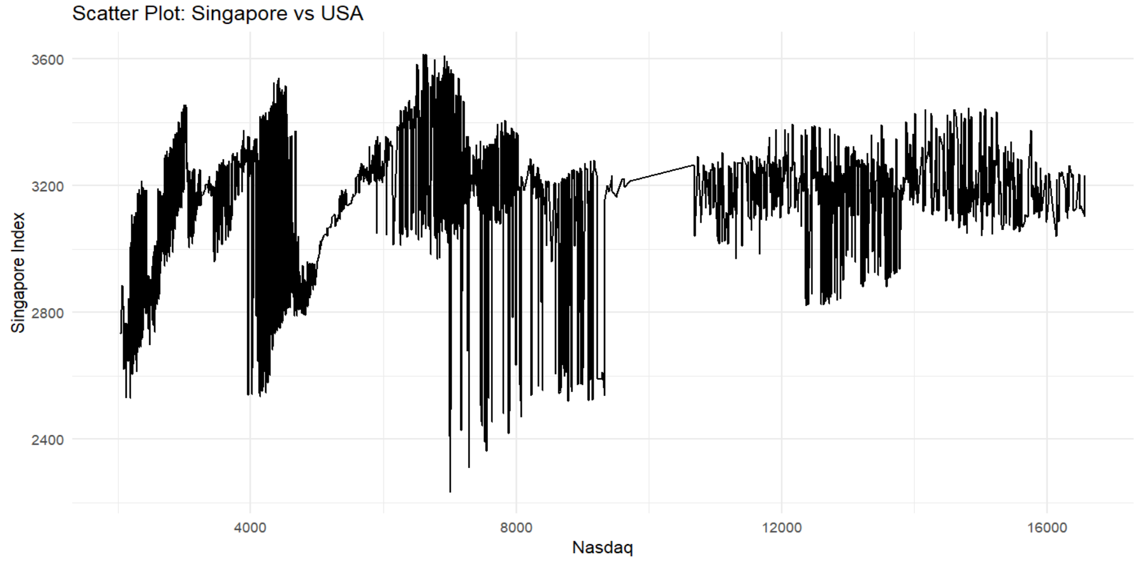
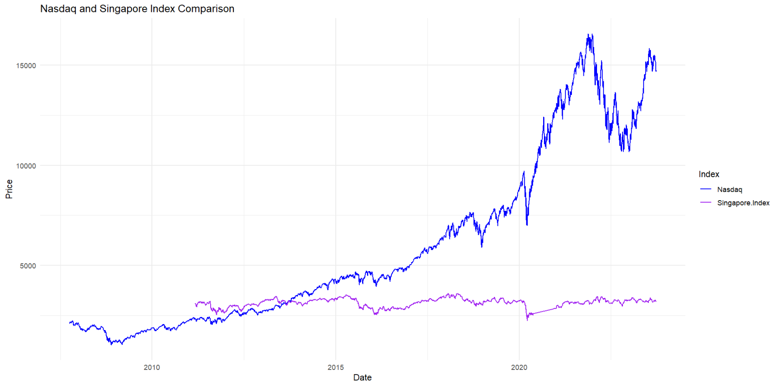
USA and SINGAPORE
Correlation Coefficient = 0.21

Slide 17
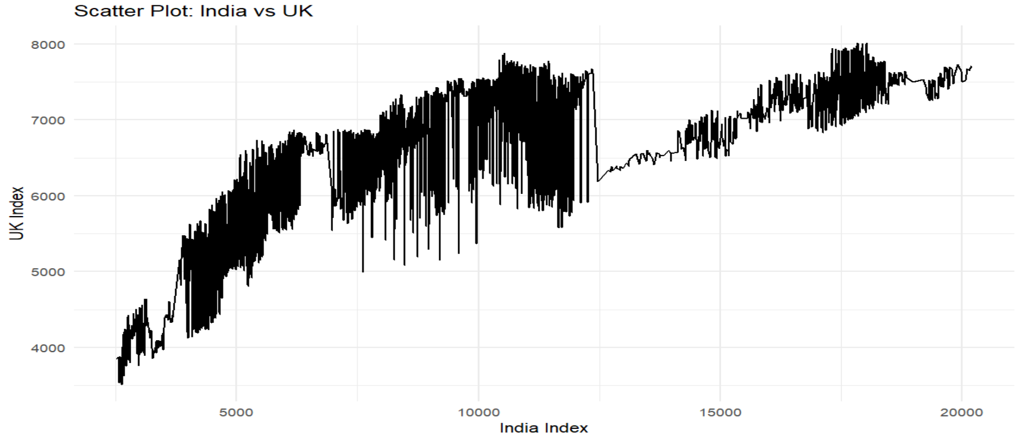
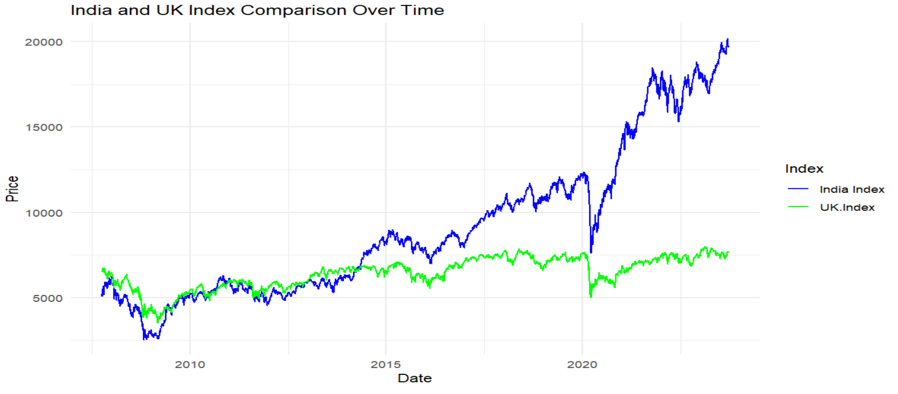
INDIA and UK
Correlation Coefficient = 0.754

Slide 18
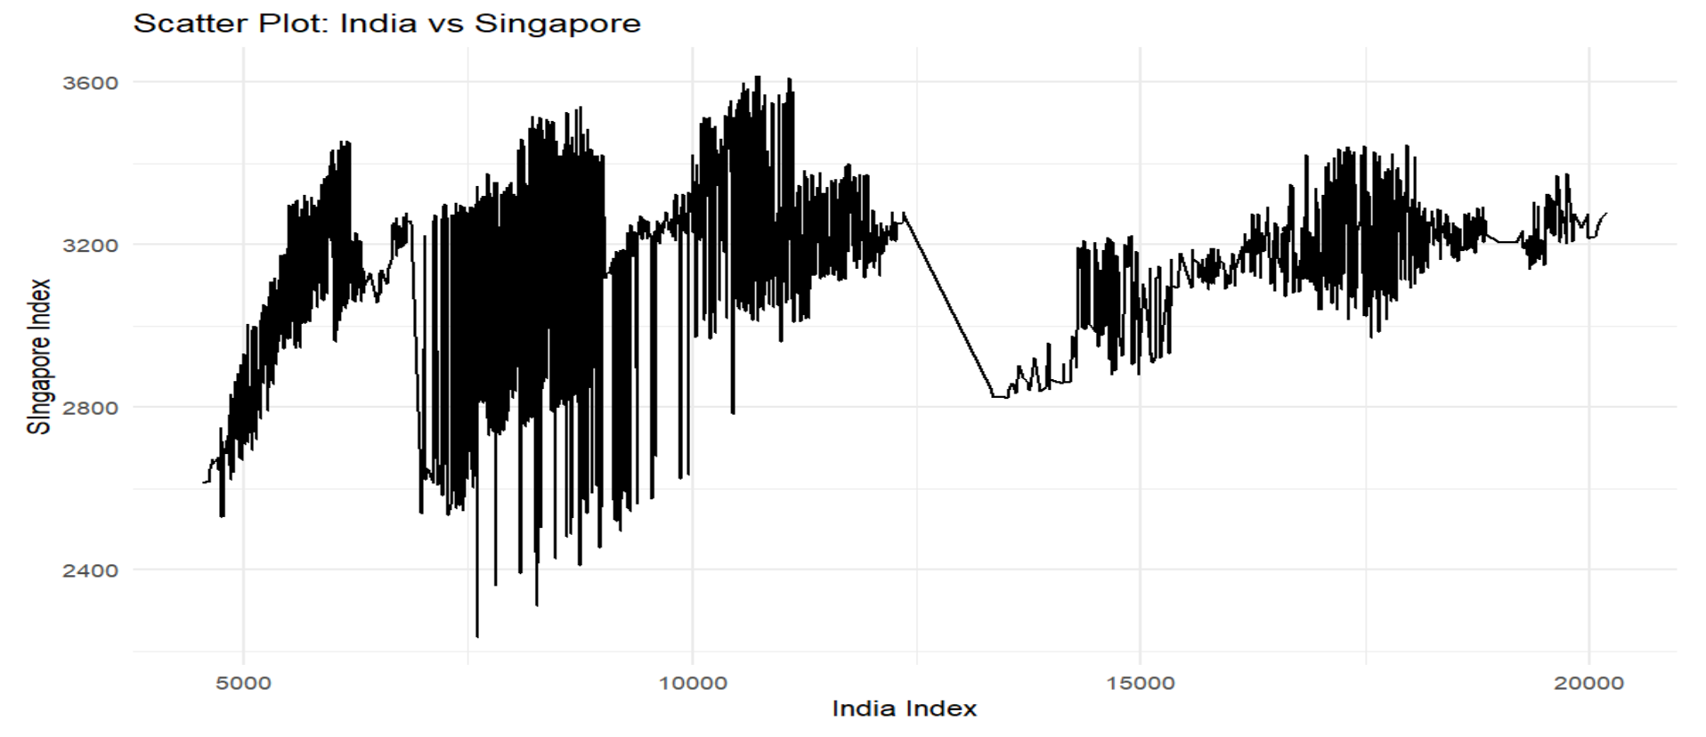
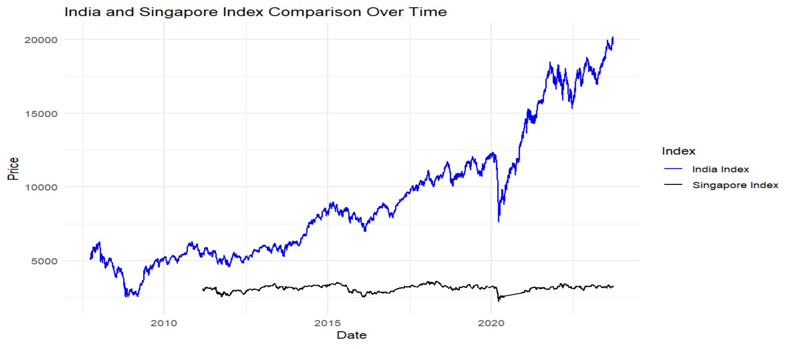
INDIA and SINGAPORE
Correlation Coefficient = 0.30

Slide 19
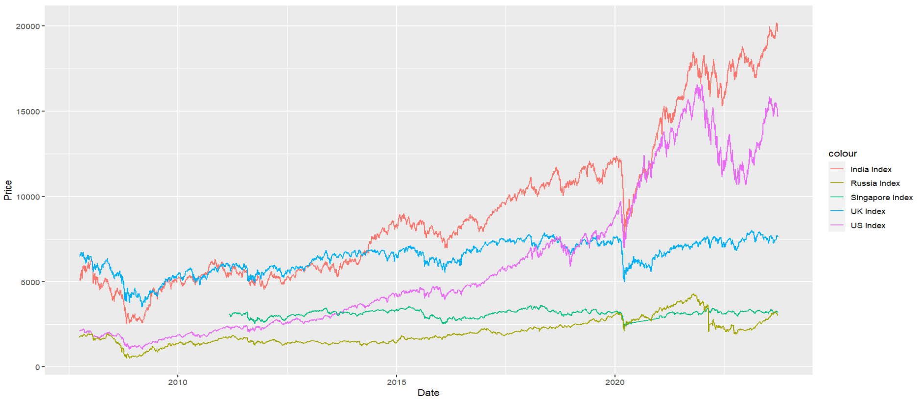
Comparison of Various Countries Indexes Over Time

